Slide 1
Graph traversals

Slide 2
Outline
We will look at traversals of graphs
Breadth-first or depth-first traversals
Must avoid cycles
Depth-first traversals can be recursive or iterative
Problems that can be solved using traversals

Slide 3
Strategies
Traversals of graphs are also called searches
We can use either breadth-first or depth-first traversals
Breadth-first requires a queue
Depth-first requires a stack
We each case, we will have to track which vertices have been visited requiring Θ(|V|) memory
One option is a hash table
If we can use a bit array, this requires only |V|/8 bytes
The time complexity cannot be better than and should not be worse than Θ(|V| + |E|)
Connected graphs simplify this to Θ(|E|)
Worst case: Θ(|V^{|2})

Slide 4
Breadth-first traversal
Consider implementing a breadth-first traversal on a graph:
Choose any vertex, mark it as visited and push it onto queue
While the queue is not empty:
Pop to top vertex v from the queue
For each vertex adjacent to v that has not been visited:
Mark it visited, and
Push it onto the queue
This continues until the queue is empty
Note: if there are no unvisited vertices, the graph is connected,

Slide 5
Iterative depth-first traversal
An implementation can use a queue
void Graph::depth_first_traversal( Vertex *first ) const {
unordered_map<Vertex *, int> hash;
hash.insert( first );
std::queue<Vertex *> queue;
queue.push( first );
while ( !queue.empty() ) {
Vertex *v = queue.front();
queue.pop();
// Perform an operation on v
for ( Vertex *w : v->adjacent_vertices() ) {
if ( !hash.member( w ) ) {
hash.insert( w );
queue.push( w );
}
}
}
}

Slide 6
Breadth-first traversal
The size of the queue is O(|V|)
The size depends both on:
The number of edges, and
The out-degree of the vertices

Slide 7
Depth-first traversal
Consider implementing a depth-first traversal on a graph:
Choose any vertex, mark it as visited
From that vertex:
If there is another adjacent vertex not yet visited, go to it
Otherwise, go back to the most previous vertex that has not yet had all of its adjacent vertices visited and continue from there
Continue until no visited vertices have unvisited adjacent vertices
Two implementations:
Recursive
Iterative

Slide 8
Recursive depth-first traversal
A recursive implementation uses the call stack for memory:
void Graph::depth_first_traversal( Vertex *first ) const {
std::unordered_map<Vertex *, int> hash;
hash.insert( first );
first->depth_first_traversal( hash );
}
void Vertex::depth_first_traversal( unordered_map<Vertex *, int> &hash ) const {
// Perform an operation on this
for ( Vertex *v : adjacent_vertices() ) {
if ( !hash.member( v ) ) {
hash.insert( v );
v->depth_first_traversal( hash );
}
}
}

Slide 9
Iterative depth-first traversal
An iterative implementation can use a stack
void Graph::depth_first_traversal( Vertex *first ) const {
unordered_map<Vertex *, int> hash;
hash.insert( first );
std::stack<Vertex *> stack;
stack.push( first );
while ( !stack.empty() ) {
Vertex *v = stack.top();
stack.pop();
// Perform an operation on v
for ( Vertex *w : v->adjacent_vertices() ) {
if ( !hash.member( w ) ) {
hash.insert( w );
stack.push( w );
}
}
}
}

Slide 10
Iterative depth-first traversal
If memory is an issue, we can reduce the stack size:
For the vertex:
Mark it as visited
Perform an operation on that vertex
Place it onto an empty stack
While the stack is not empty:
If the vertex on the top of the stack has an unvisited adjacent vertex,
Mark it as visited
Perform an operation on that vertex
Place it onto the top of the stack
Otherwise, pop the top of the stack

Slide 11
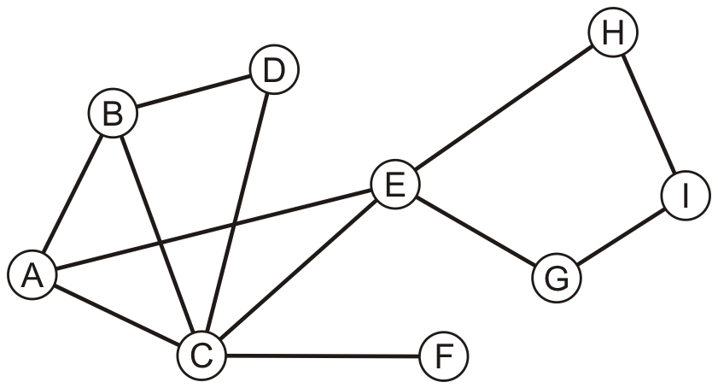
Example
Consider this graph

Slide 12
Example
Performing a breadth-first traversal
Push the first vertex onto the queue
A

Slide 13
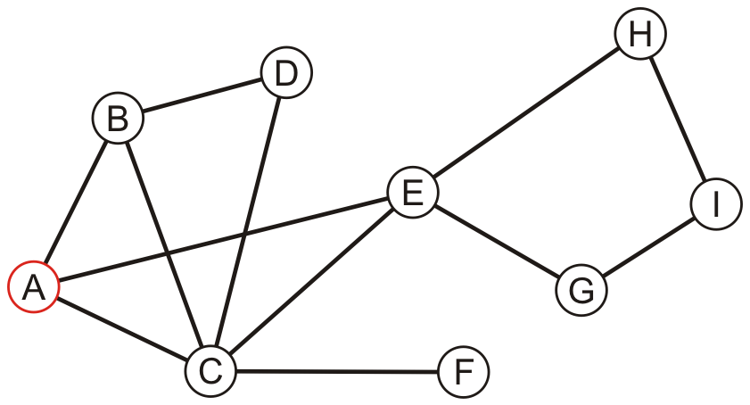
Example
Performing a breadth-first traversal
Pop A and push B, C and E
A
B | C | E

Slide 14
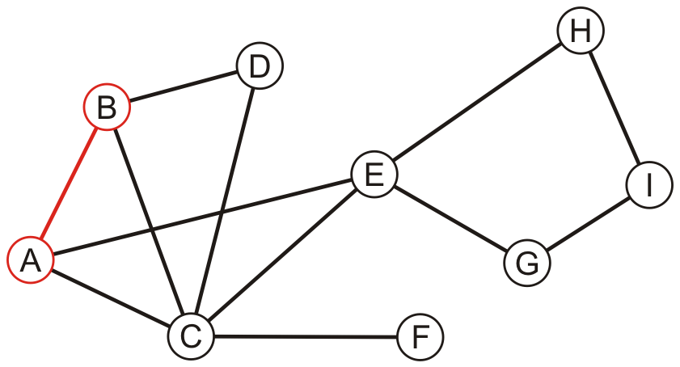
Example
Performing a breadth-first traversal:
Pop B and push D
A, B
C | E | D

Slide 15
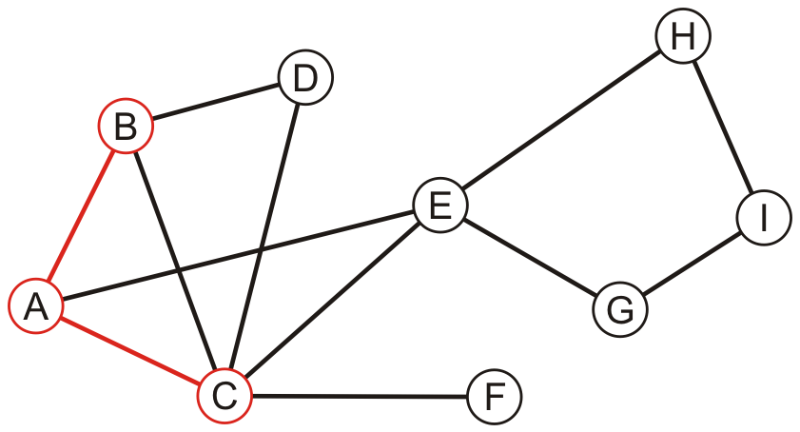
Example
Performing a breadth-first traversal:
Pop C and push F
A, B, C
E | D | F

Slide 16
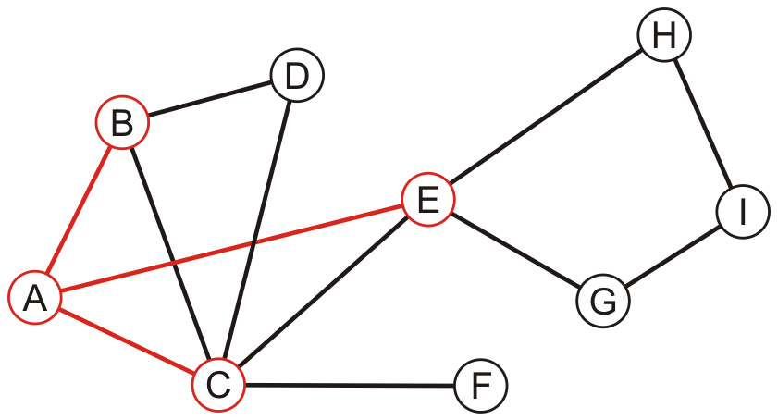
Example
Performing a breadth-first traversal:
Pop E and push G and H
A, B, C, E
D | F | G | H

Slide 17
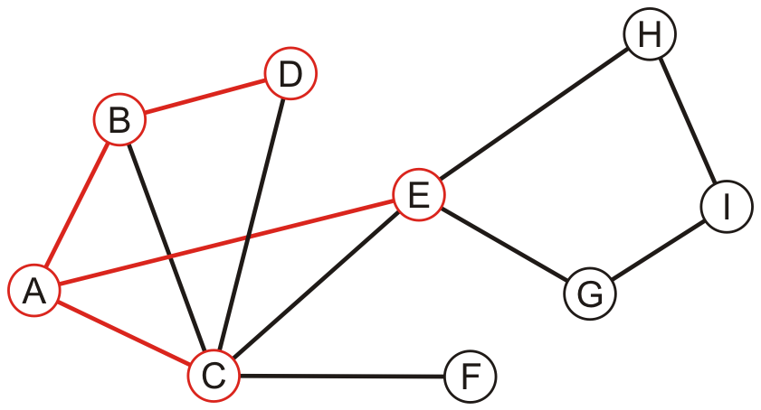
Example
Performing a breadth-first traversal:
Pop D
A, B, C, E, D
F | G | H

Slide 18
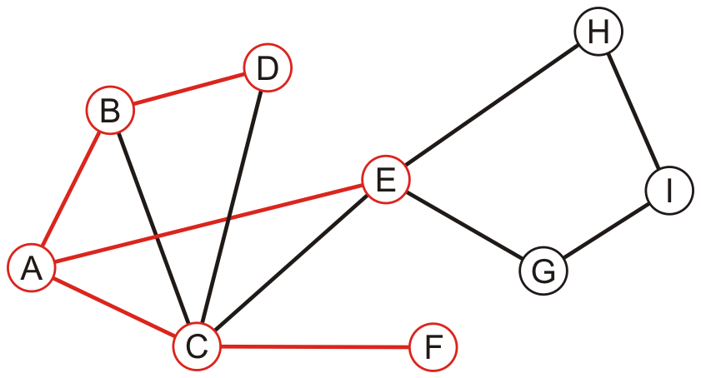
Example
Performing a breadth-first traversal:
Pop F
A, B, C, E, D, F
G | H

Slide 19
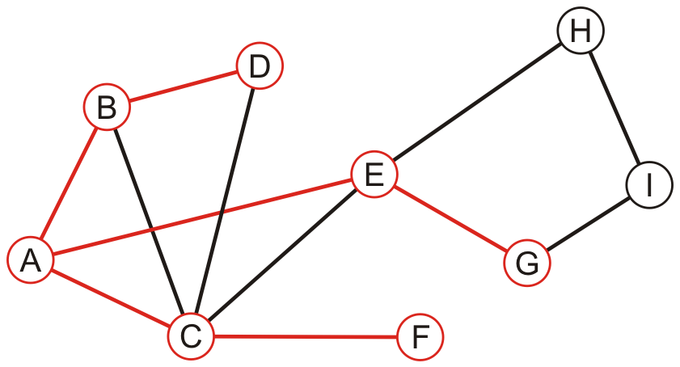
Example
Performing a breadth-first traversal:
Pop G and push I
A, B, C, E, D, F, G
H | I

Slide 20
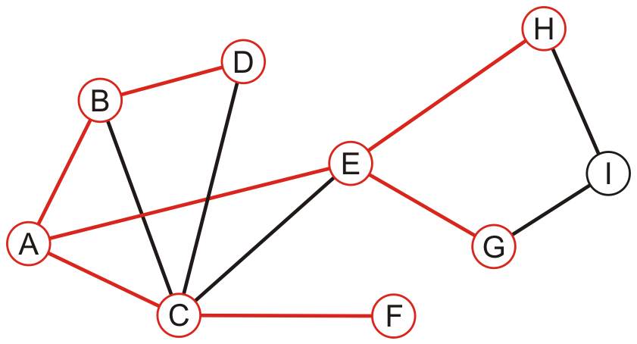
Example
Performing a breadth-first traversal:
Pop H
A, B, C, E, D, F, G, H
I

Slide 21
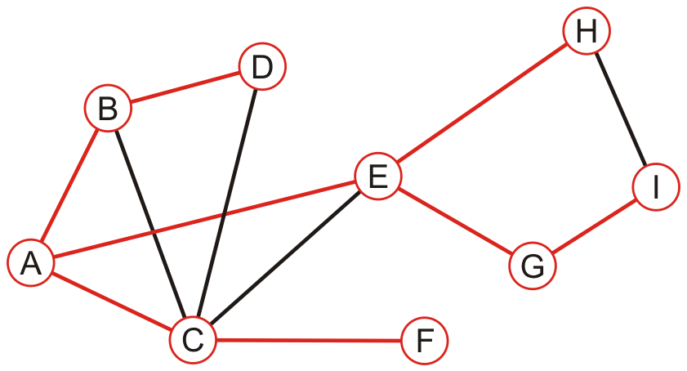
Example
Performing a breadth-first traversal:
Pop I
A, B, C, E, D, F, G, H, I

Slide 22
Example
Performing a breadth-first traversal:
The queue is empty: we are finished
A, B, C, E, D, F, G, H, I

Slide 23
Example
Perform a recursive depth-first traversal on this same graph

Slide 24
Example
Performing a recursive depth-first traversal:
Visit the first node
A

Slide 25
Example
Performing a recursive depth-first traversal:
A has an unvisited neighbor
A, B

Slide 26
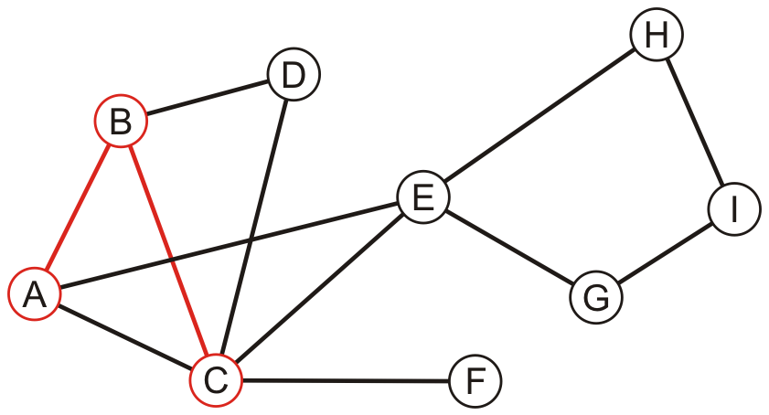
Example
Performing a recursive depth-first traversal:
B has an unvisited neighbor
A, B, C

Slide 27
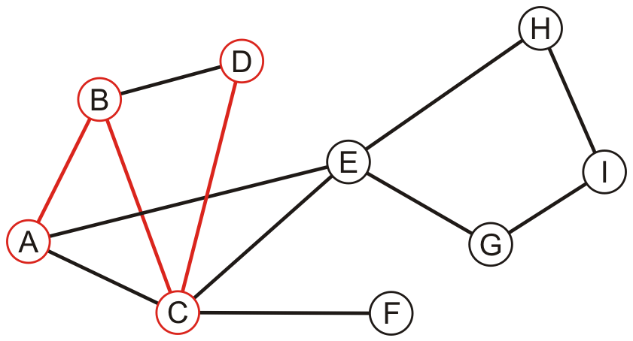
Example
Performing a recursive depth-first traversal:
C has an unvisited neighbor
A, B, C, D

Slide 28
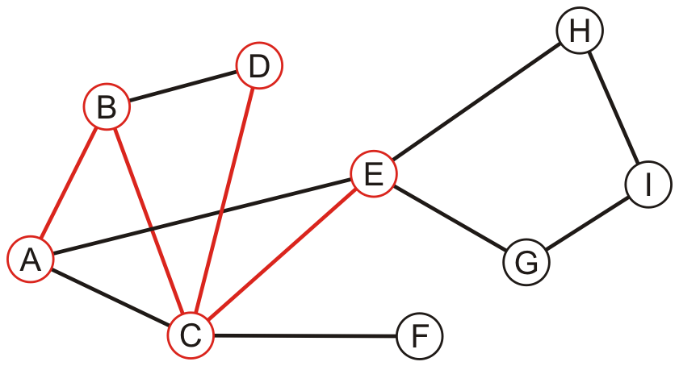
Example
Performing a recursive depth-first traversal:
D has no unvisited neighbors, so we return to C
A, B, C, D, E

Slide 29
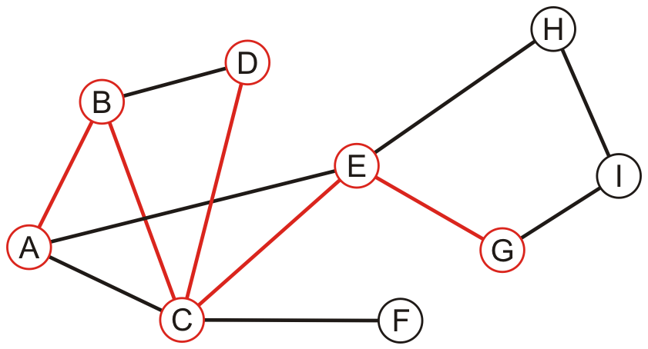
Example
Performing a recursive depth-first traversal:
E has an unvisited neighbor
A, B, C, D, E, G

Slide 30
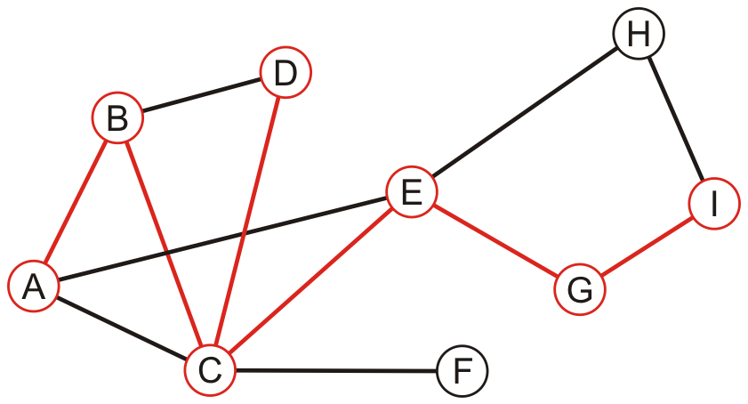
Example
Performing a recursive depth-first traversal:
F has an unvisited neighbor
A, B, C, D, E, G, I

Slide 31
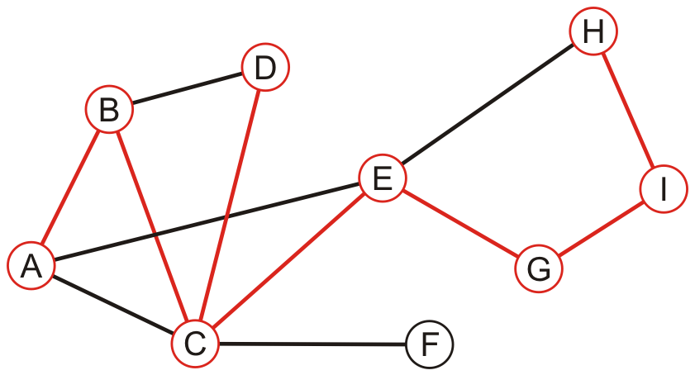
Example
Performing a recursive depth-first traversal:
H has an unvisited neighbor
A, B, C, D, E, G, I, H

Slide 32
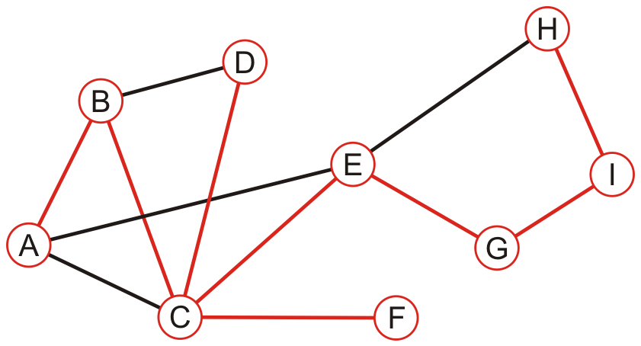
Example
Performing a recursive depth-first traversal:
We recurse back to C which has an unvisited neighbour
A, B, C, D, E, G, I, H, F

Slide 33
Example
Performing a recursive depth-first traversal:
We recurse finding that no other nodes have unvisited neighbours
A, B, C, D, E, G, I, H, F

Slide 34
Comparison
Performing a recursive depth-first traversal:
We recurse finding that no other nodes have unvisited neighbours
A, B, C, D, E, G, I, H, F

Slide 35
Comparison
The order in which vertices can differ greatly
An iterative depth-first traversal may also be different again
A, B, C, E, D, F, G, H, I
A, B, C, D, E, G, I, H, F

Slide 36
Applications
Applications of tree traversals include:
Determining connectiveness and finding connected sub-graphs
Determining the path length from one vertex to all others
Testing if a graph is bipartite
Determining maximum flow
Cheney’s algorithm for garbage collection

Slide 37
Summary
This topic covered graph traversals
Considered breadth-first and depth-first traversals
Depth-first traversals can recursive or iterative
More overhead than traversals of rooted trees
Considered a STL approach to the design
Considered an example with both implementations
They are also called searches

Slide 38
References
Wikipedia, http://en.wikipedia.org/wiki/Graph_traversal
http://en.wikipedia.org/wiki/Depth-first_search
http://en.wikipedia.org/wiki/Breadth-first_search
These slides are provided for the ECE 250 Algorithms and Data Structures course. The material in it reflects Douglas W. Harder’s best judgment in light of the information available to him at the time of preparation. Any reliance on these course slides by any party for any other purpose are the responsibility of such parties. Douglas W. Harder accepts no responsibility for damages, if any, suffered by any party as a result of decisions made or actions based on these course slides for any other purpose than that for which it was intended.

